Slide 1
ASP.NET MVC Environment
Date

Slide 2
Software Requirements
OS – Windows Vista Service Pack2, Windows 7 and Windows 8 /10
.NET Framework – 4.5
IDE – Visual Studio 2012/2013 Professional/Premium/Ultimate/Express
Database – SQL Server Express 2012 or above

Slide 3
Microsoft Web Platform Installer
Free Tool
Makes getting the latest components of the MS Web Platform including IIS, SQL Server Express, .NET Framework and Visual Web Developer easy
Installs the express(free) version

Slide 4
Microsoft Web Platform Installer
Go to the link
http://www.microsoft.com/web/downloads/platfor m.aspx
Or search for Web Platform Installer

Slide 5
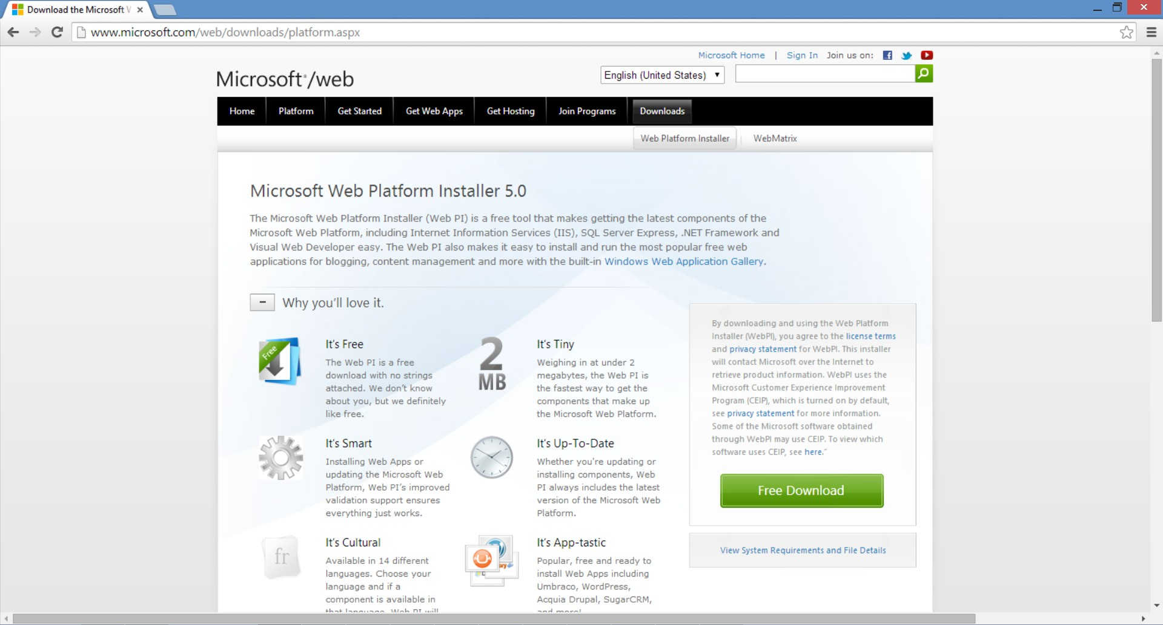
Microsoft Web Platform Installer

Slide 6
Microsoft Web Platform Installer
Click on the Free Download button
wpilauncher is downloaded

Slide 7
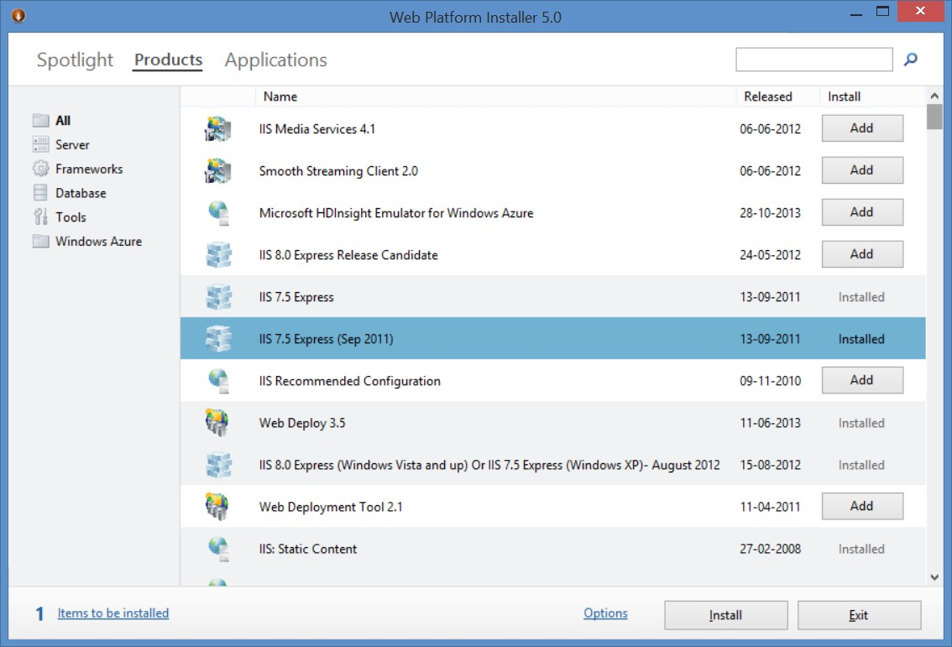
Microsoft Web Platform Installer

